Slide 1


CEIS312 Final Project Home Construction and Methods to Decrease Energy Consumption Via Heating Load
Edward Alvarado
November 2022

Slide 2
Introduction
As engineers we pride ourselves in taking a problem and finding a solution to meet the clients needs in a professional manner. From design inception to implementation, we utilize process improvement techniques work lean and efficiently.
Within the following presentation we’ll discuss:
Process Improvement Techniques.
Review Visual Aids
Creating Graphs
Machine Learning
Linear Regression
Challenges
Career Skills Obtained

Slide 3

Process Improvement Techniques
Planning your Project
Properly planning out a project is vital success. We need to ensure all variables are reviewed up front along with expected deliverables and requirements to allow for proper planning.
It can be argued that a project that didn’t take the appropriate amount of setup time is almost doomed to fail as variables arise.
View Project Planning as setting up the foundation of a building, without strong support it may just crumble.
Data Cleaning
When dealing with large sets of data it can be hard to know what is valuable and what is noise. Utilizing data cleaning allows us to root out data variables that don’t help us use our data which in turn creates a greater degree of accuracy.

Slide 4
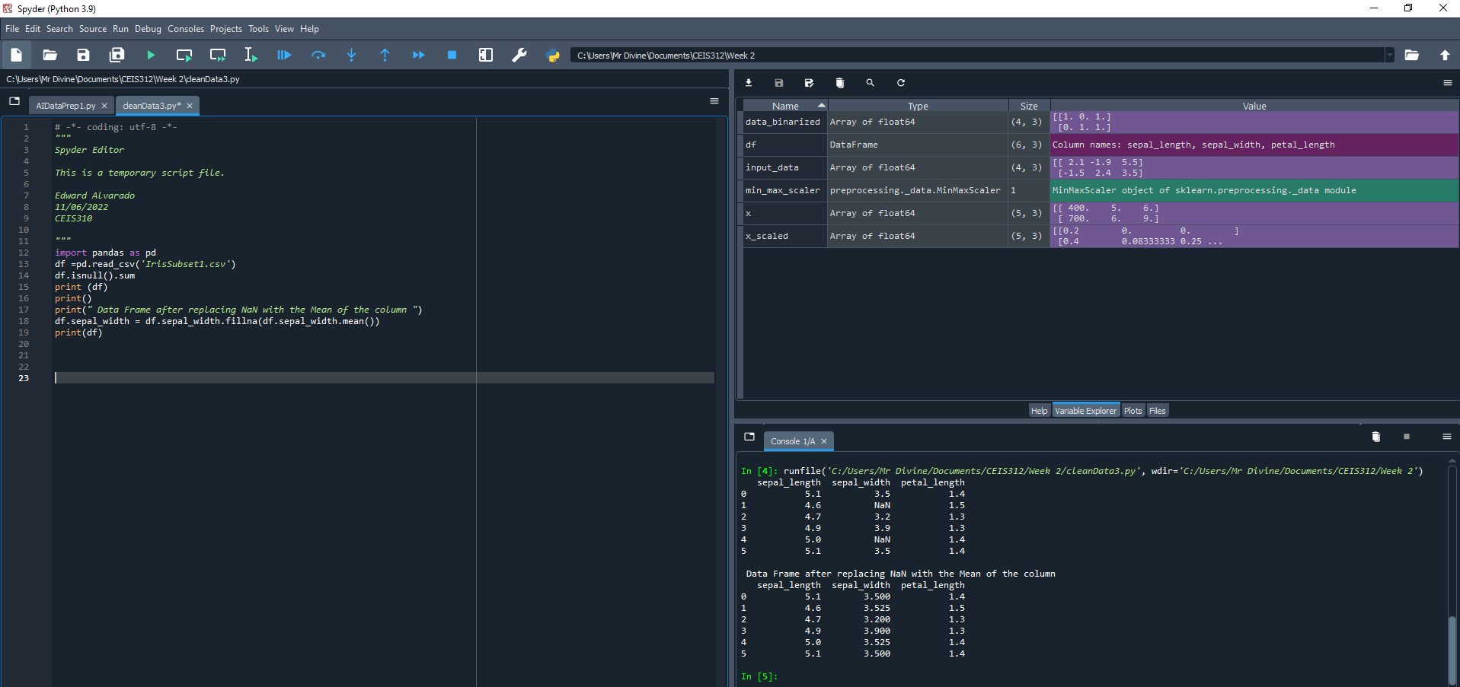
Screenshot of Activity A
The following shows basic python script utilizing some data cleaning

Slide 5
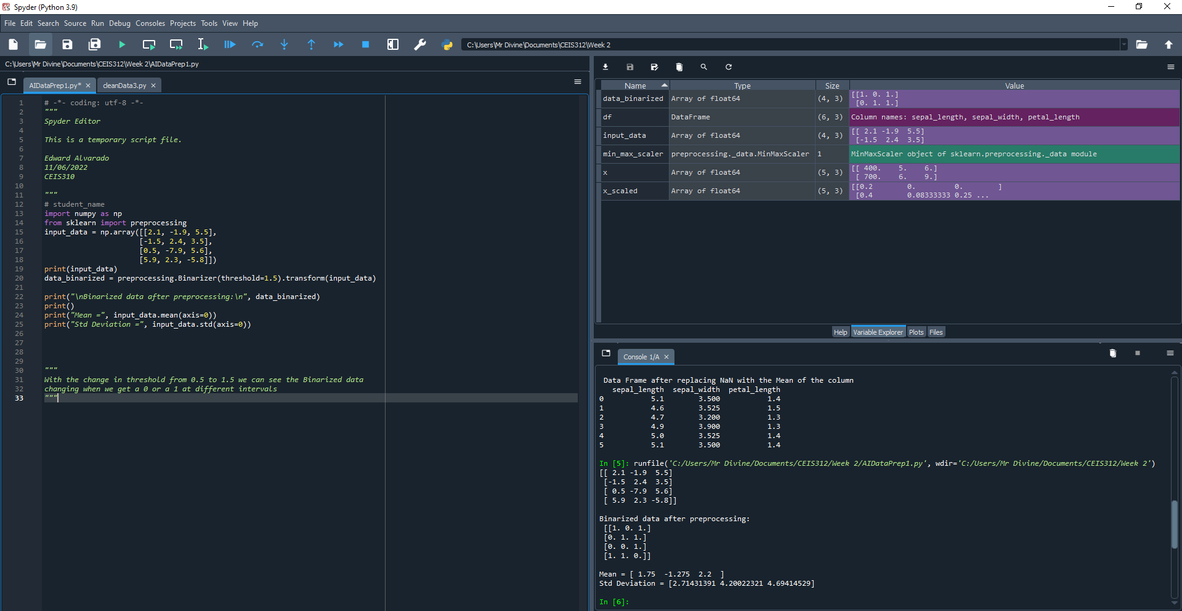
Screenshot of Activity B
The following shows basic python script utilizing some data cleaning

Slide 6

Machine Learning
Accessing and Exploring Machine Learning Datasets
In the following slides we’ll be reviewing machine learning with a provided data set using Python.
Generating our own Data Set
We’ll also be using Python to review and display information on our own data set on Esports statistics.

Slide 7
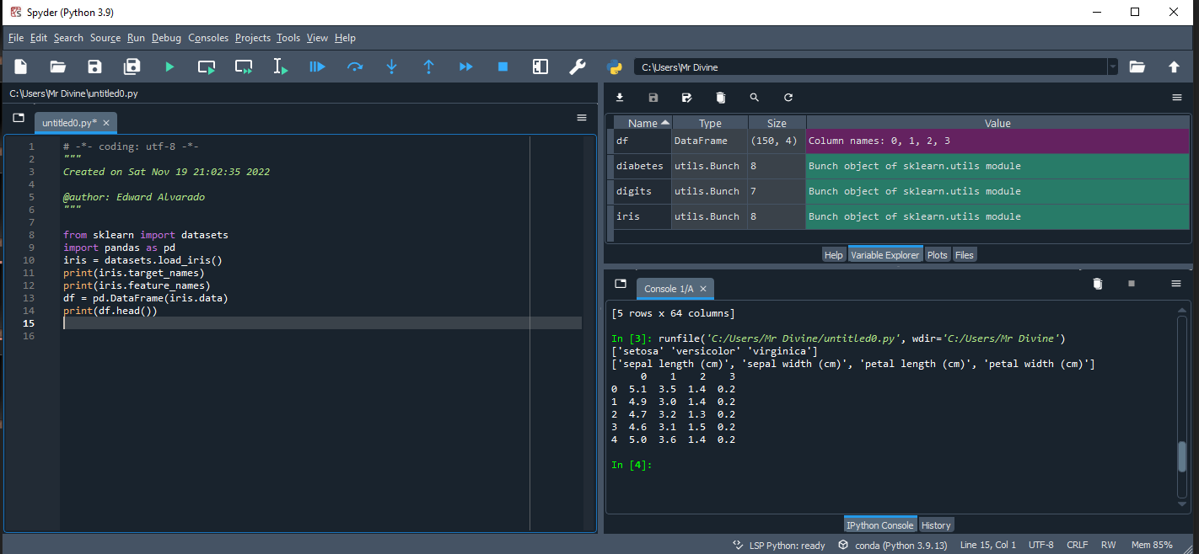
Screenshot of Activity 1
A Screenshot showing python being used to show data information on flowers.

Slide 8
Screenshot of Dataset
The following are datasets explored at Kaggle and UCI websites. These repositories are public sites where people can upload datasets.
Name three interesting datasets you find at the Kaggle website.
Esports Earnings Dataset. Money earned by Players and Teams from eSports Tournaments
https://www.kaggle.com/datasets/jackdaoud/esports-earnings-for-players-teams-by-game
RuneScape Grand Exchange Data. The data set contains the daily price average for items listed on the RuneScape 3 grand exchange from 2008 to today. Prices within the grand exchange fluctuate based on player supply and demand.
https://www.kaggle.com/datasets/aparoski/runescape-grand-exchange-data
COVID -19 Coronavirus Pandemic Dataset
https://www.kaggle.com/datasets/whenamancodes/covid-19-coronavirus-pandemic-dataset
Name three interesting datasets you find at the UCI.
Speaker Accent Recognition Data Set
https://archive.ics.uci.edu/ml/datasets/Speaker+Accent+Recognition
Absenteeism at work Data Set
https://archive.ics.uci.edu/ml/datasets/Absenteeism+at+work
Bias correction of numerical prediction model temperature forecast Data Set
https://archive.ics.uci.edu/ml/datasets/Bias+correction+of+numerical+prediction+model+temperature+forecast

Slide 9
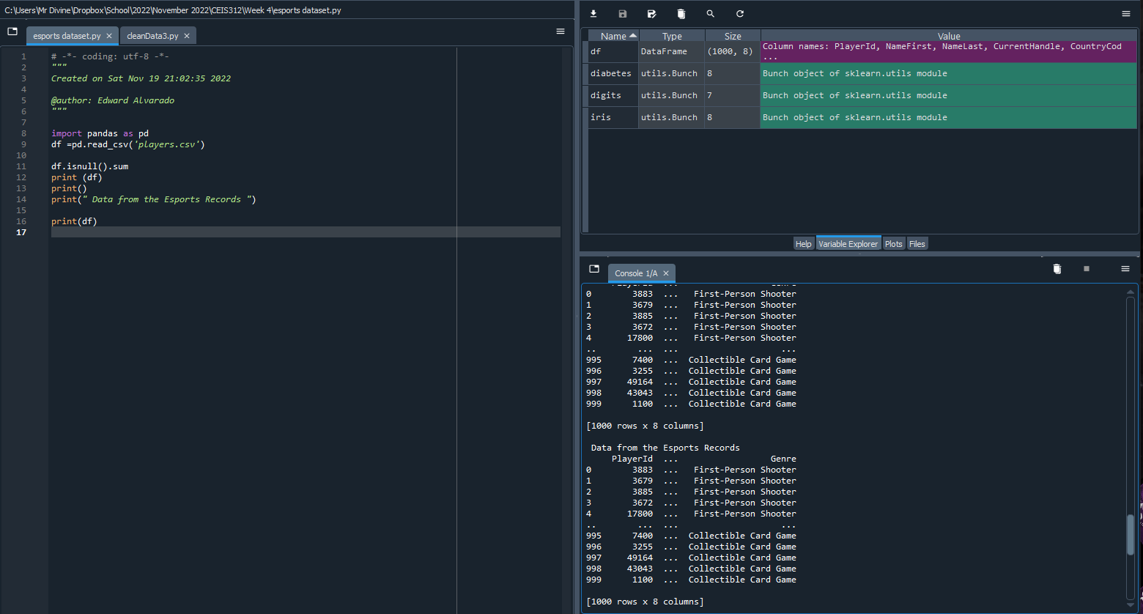
Screenshot of Activity 2
The following shows python being used to review a data set that contains statistics on Esports organizations.

Slide 10
Home Construction and Heating Load
In the following slides we’ll be reviewing the importance heating load makes on the construction of a home.
What factors impact the heating load.
And how we can utilize machine learning to take large sets of data to find the answers we’re looking for.

Slide 11
Heating Load
What is Heating Load?
The heating load is the amount of heat energy that would need to be added to a space to maintain the temperature in an acceptable range. The cooling load is the amount of heat energy that would need to be removed from a space (cooling) to maintain the temperature in an acceptable range.
Why this is important in-home construction is the simple fact that lower thermal loads mean less heating and cooling are required to maintain comfortable temperatures within a home which in turn reduces energy consumption by devices like an Air Conditioner.

Slide 12
Azure Machine Learning
Azure machine learning is an online platform that is dedicated to the task of machine learning using pre-built algorithms.
We’re able to upload our own dataset into the system
We can then use previous data cleaning methods to ensure our data is accurate
We then evaluate the importance of variables in our data set to determine if anything can be pruned
Finally we use Linear regression and train our model to determine what variables have the largest impact to our heating load.

Slide 13
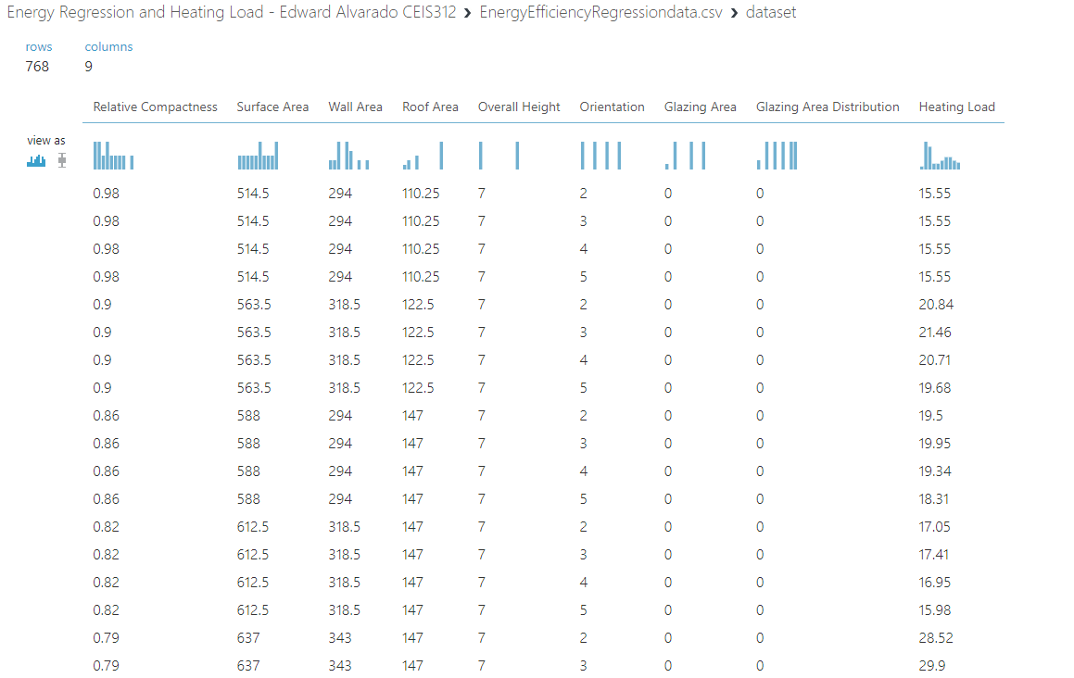
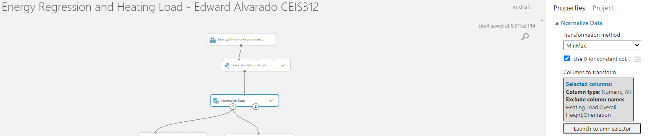
Step 1 Uploading our Data Set and Cleaning
We first upload our data set and normalize the data. In this normalization we transform our data using MinMax, use 0 for constant columns and exclude heating load, overall height and orientation from our dataset.

Slide 14
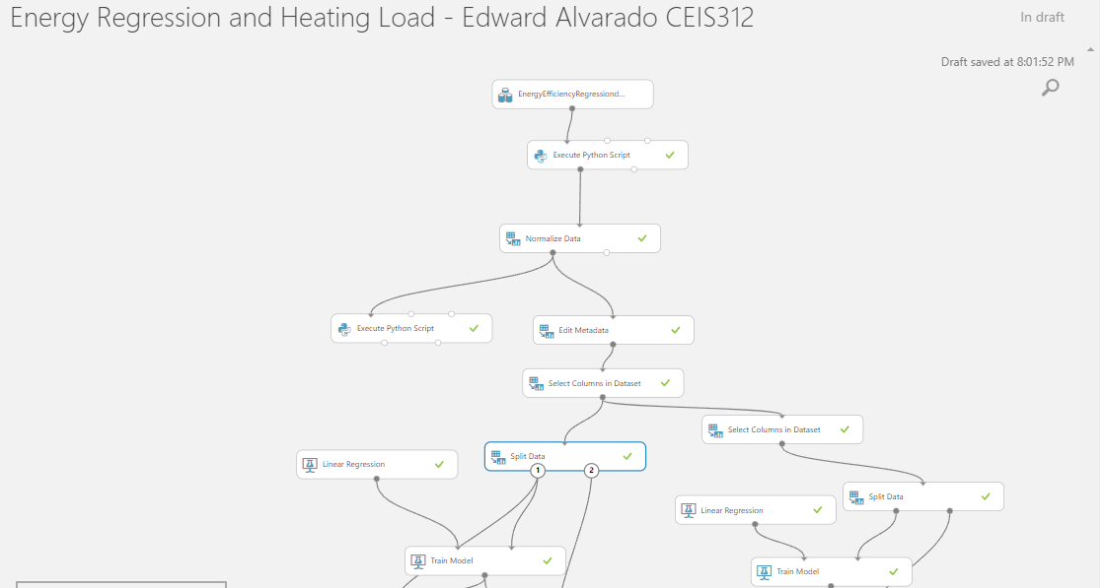
Step 2 Splitting Data and Evaluating
The purpose of step 2 is to split our data into two identical copies. We can then adjust what we include or exclude from the data set to see which model performs better

Slide 15
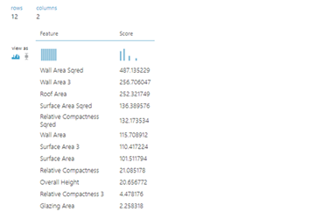
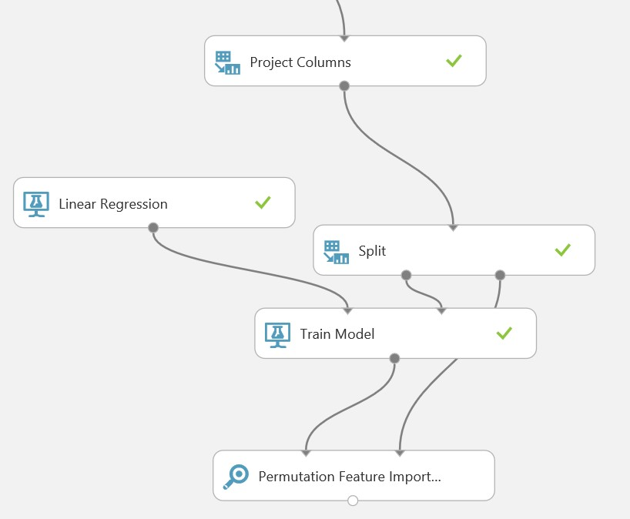
Step 3 Evaluating Feature Importance
In this step we take our cleaned data and figure out the general feature importance of each variable

Slide 16
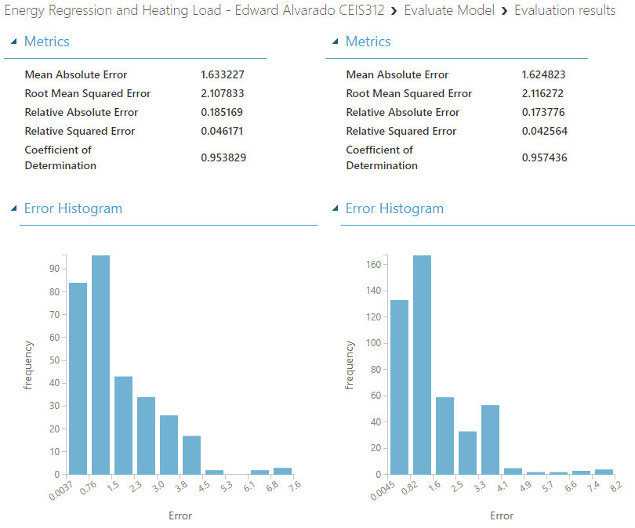
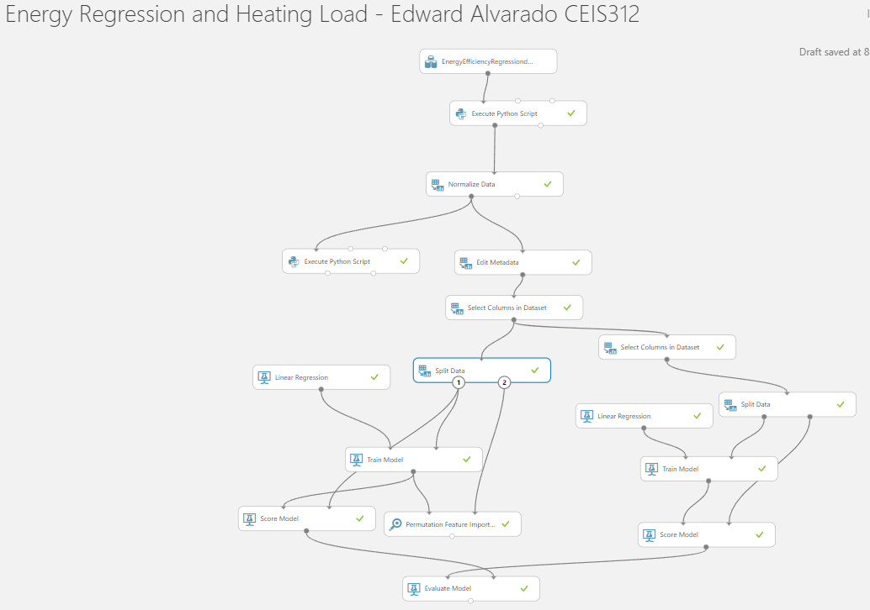
Step 4 Evaluating our Models
In our final step we evaluate our two models to compare the coefficient of determination.

Slide 17
Challenges
The main challenges I ran into during this course was the implementation and setup of Anaconda/Spyder. Since I’ve taken a few programming courses in the past I’ve downloaded most of these programs previously just with out of data versions. Eventually after going through a clean install, I was able to resolve most of the technical issues
I also troubleshooted a few errors while running some of the python script, taking the time to properly read the console for error messages help tremendously with error troubleshooting.

Slide 18
Career Skills Obtained
Process Improvement Skills
Six Sigma
Working Lean
Proper Project Planning
Agile Workflow
Python Programming using Spyder
Machine Learning using both Spyder and Azure Machine Learning
Microsoft PowerPoint, Excel and Word Experience

Slide 19
References
Heating and cooling loads. BASIX. (n.d.). Retrieved December 16, 2022, from https://www.basix.nsw.gov.au/iframe/thermal-help/heating-and-cooling-loads.html#:~:text=The%20heating%20load%20is%20the,temperature%20in%20an%20acceptable%20range.

Slide 20
Conclusion
This course object was to bring awareness, instigate interest, and promote the need of using AI and machine learning algorithms and tools for process improvement. This project covers data cleansing, exploratory data analysis, feature selection, and evaluating machine learning algorithms for regression using train/test split.
By Utilizing the skills gained throughout this course we not only learned how to improve processes in every stage of development, but we were also able to take real world data and use the skills we acquired to answer impactful questions.

